Slide 1

ENGINEERING DESIGN 2026
GENERAL FEEDBACK

Slide 2
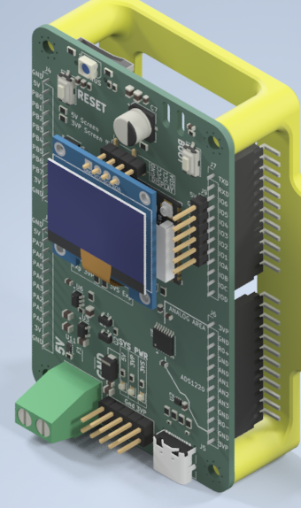
MAIN CONTROL BOARD
At a glance
Prototype successfully completed
SPWM implemented, 3 or 6 IO, 10 kHz switching freq
ADC ADS1220 on SPI
Port Expander 2x 8bit ports (15 usable)
uSD Card and RTCC support
RGB Status LED

Slide 3

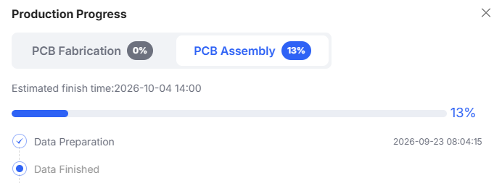
MAIN CONTROL BOARD
In Production
Chinese Mid-Autumn Holiday period leads to factory shutdowns
Completion estimate is 4 October

Slide 4

DELIVERY ESTIMATE
9 OCTOBER 2026
Boards arrive partially assembled.
Connectors must be soldered by individual groups.

Slide 5
Interface protection

Slide 6
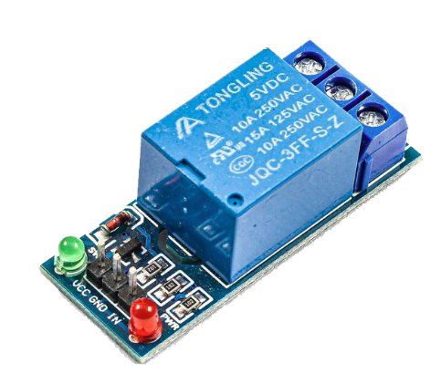
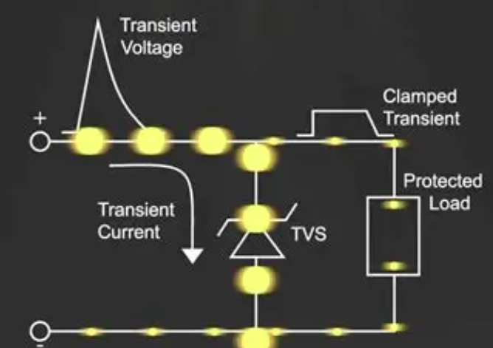
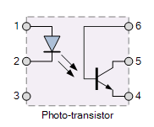
WHY BOTHER
Dealing with transients
Products necessitates interfacing low-voltage and high voltage
  Inverter control
  General switching applications
  Field-bus transients
Fast
Potential for galvanic isolation
Slow
Galvanic isolation, direct mains switching
Very Fast (8us)
Alternative path provision

Slide 7
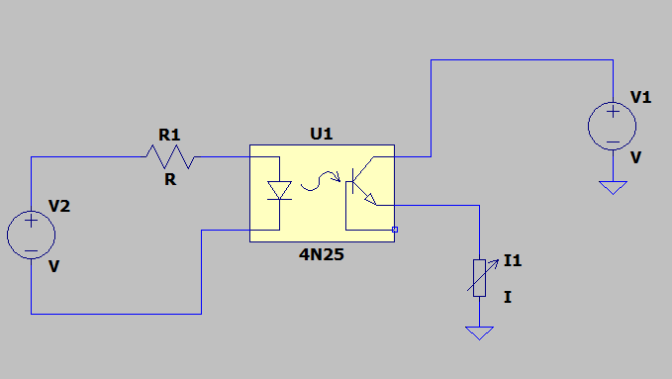
OPTICAL ISOLATION
Low Voltage Differentials
V2 via R1 supplies LED in U1
Transistor in U1 low side switch
L1 fed via V1
  No current limiting
Switching is limited to Vce max

Slide 8
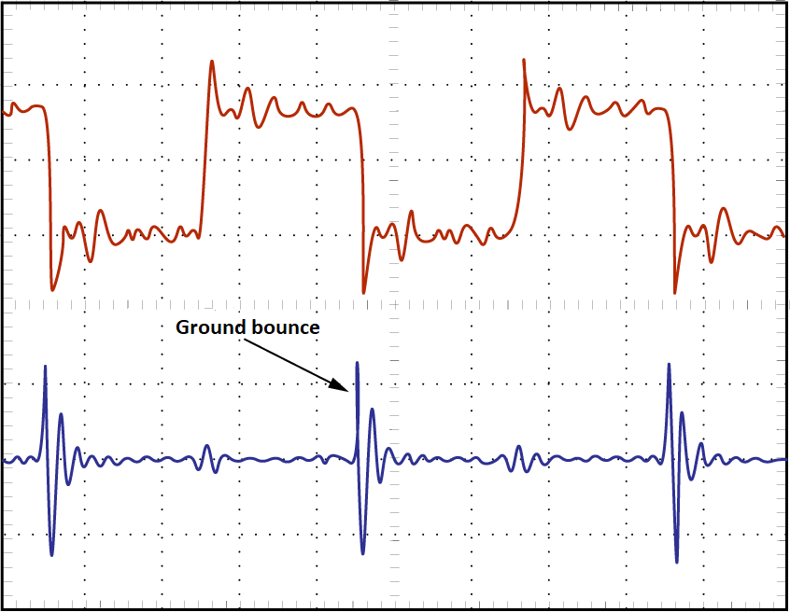
SWITCHING LOADS
What happens to voltages…
Ground is not perfect 0R
Distributed L and C induces voltage transients
3V MCU
  High 3V, Low 0V
  0.8V bounce > High 2.2V, Low -0.8V
2.2V nuisance sporadic behaviour
-0,8V input > Blown MCU

Slide 9
OPTICAL ISOLATION
Correct usage
MCU Loop (V2) completely isolated
Worst case V1 loop spike destroys U1

Slide 10
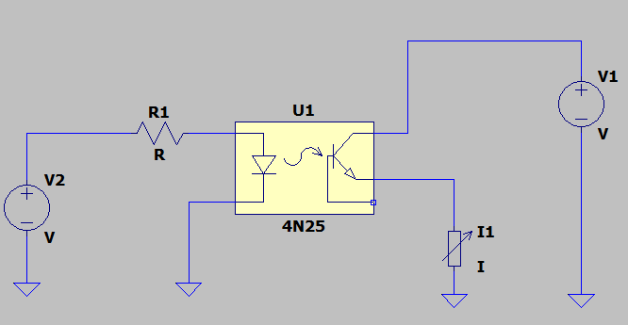
A typical implementation
Poor isolation performance
Shared GND offers no transient protection to MCU
U1 used as a voltage-level-translator
Very easy trap!

Slide 11
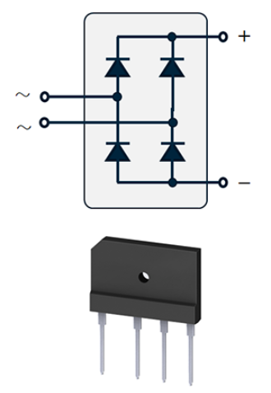
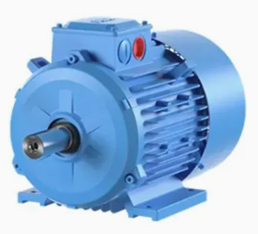
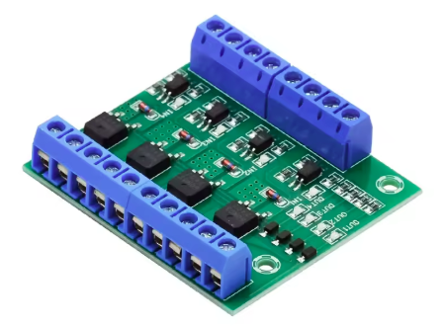
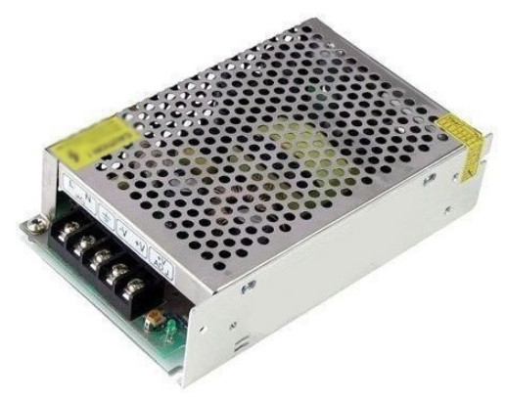
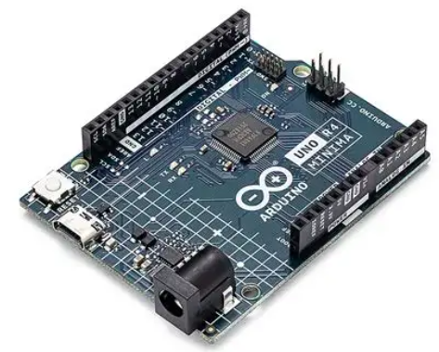
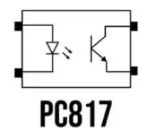
A typical configuration
Good Isolation Performance
ONLY IF PSU
PROVIDES
GALVANIC ISOLATION

Slide 12
INCREMENT 2
Start to integrate aspects.
Even a single controlled MOSFET/IGBT is significant progress.

